Slide 1


Empirical Security & Privacy, for Humans
UPenn CIS 7000-010
9/16/2025
The Cyberattack business

Slide 2
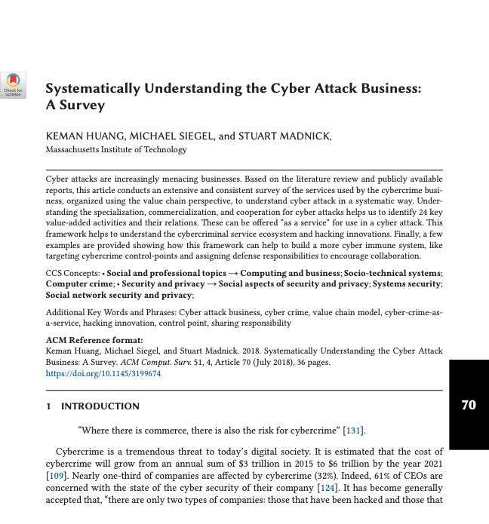
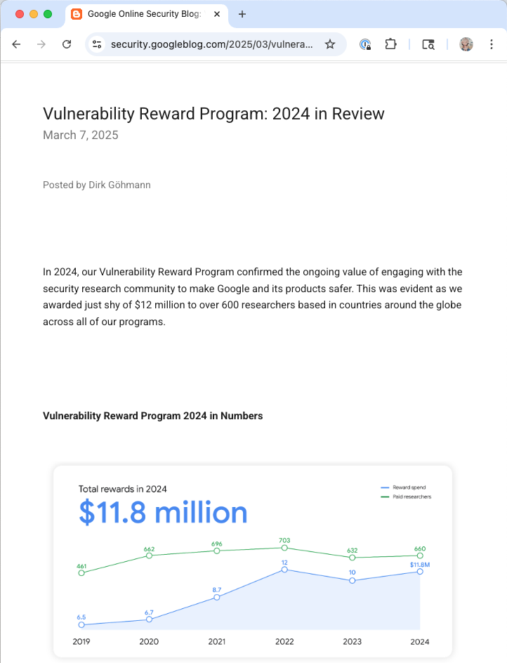
Readings

Slide 3
Readings

Slide 4
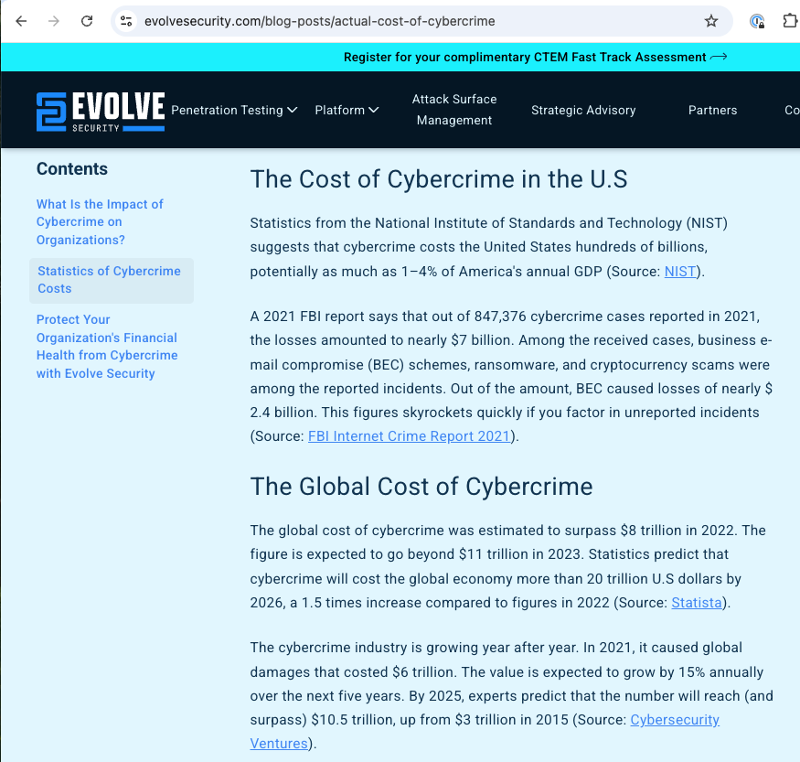
Cybercrime: Big $$
Paper: “It is estimated that the cost of cybercrime will grow from an annual sum of $3 trillion in 2015 to $6 trillion in 2021” – cited 2016 report by Cybersecurity Ventures
Evolve Security blog post (written 2023?) agrees with those numbers, estimates $20 trillion cost by 2026

Slide 5
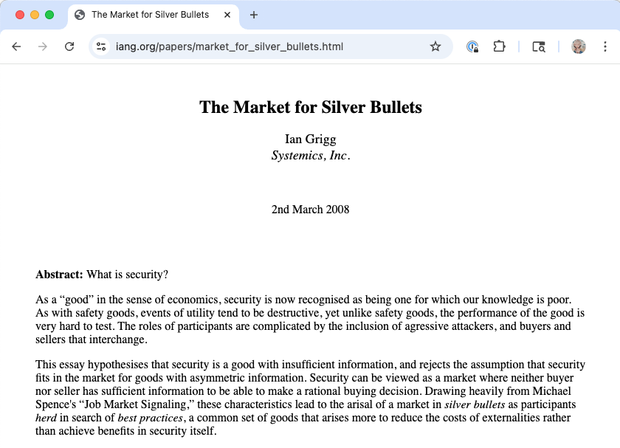
Understanding cyber criminals
Cybersecurity landscape has three main actors: victims (users), attackers, and defenders (cybersecurity product sellers)
Grigg models victims and defenders, but ignores attackers (treated like “nature” in safety assessments)
Hypothesis of Huang et al. paper: Understanding attackers and the business of cybercrime offers opportunities for better defense

Slide 6
Approach
Survey the literature that reveals the various practices of the cybercrime business
Develop a framework in which to categorize and group these practices: The cybercriminal value chain model
Vulnerability discovery, exploitation development & delivery, attack, and underlying supports
Model an observed trend: Cybercrime is organized into services
Enables specialization, commercialization, and cooperation among actors with different skillsets
All of this may reveal opportunities for disruption

Slide 7
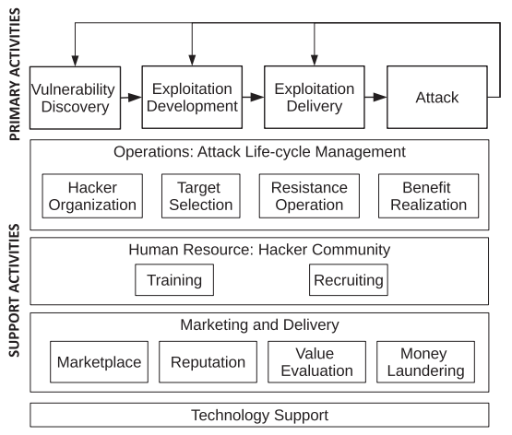
Cybercriminal Value Chain Model
Notes:
Primary:
Vulnerability: Technical (memory corruption) and operational (phishing)
Exploit development: Creation of exploit kits/packs for exploiting the vulnerability on a target. Includes “social engineering toolkit” via Metasploit!
Exploit delivery: Physical infection, electronic contact (email, SMS), drive-by-download (don’t click the link!), software distribution (corrupted install or patch; more clever: supply chain hack in open source)
Attack: The affectation of the target system. Purpose: digital gains (espionage, app theft, botnet, mule), direct monetary gains (harm competitor, ransomware 88% successful against healthcare institutions), psych gains (trophy hack)
Support: Goal is to gain greater benefit with less cost
Cyber attack ops:
- Target selection based on value prop – see next slide
- Hacker org – Hierarchy (state sponsored) vs. Aggregate (like Anonymous), and many others
- Benefit realization – basically, bitcoin via BTC-E (95% of ransomware, shut down in 2017). DDOS: with proof of participation. Black markets.
- Resistance ops: Being able to hide your tracks, recover from takedown
Human Resource
- Hacker training: two-way resources! (bug bounties etc) Also Anonymous had own school; nation states
- Hacker recruiting: same as legit recruiting! Social networks
Marketing and delivery
- Marketplace – used to find experts to fill needed skills, offer services
- Reputation – challenge! Need to earn trust (not LE or double dealer)
- Value evaluation – pricing, e.g., zero-day vs. one-day, **
- Money laundering
Tech support: IRC, Tor, Bitcoin, tools for VD and EK production, etc.
** In May, Neutrino became the primary EK distributing CryptXXX ransomware, initiating [rather: due to] a significant decline in Angler EK activity [since Angler was taken down]. As demand for Neutrino EK increased, the developers chose to increase the price of the EK from $880 per week on a shared server and $3500 per month on a dedicated server to $7000 on a dedicated server, discontinuing the shared server option

Slide 8
Cyberattack target selection rule
Expected benefit
Expected cost
Notes:
Ease of the attack P_e (ease of vuln exploitation, naivete of victim, … could be exploratory)
Potential benefit B_p = B_pm + B_mm (psych benefit + monetary benefit)
Ease of benefit realization E_r
Psychological costs C_ps
Expected penalty costs C_p = P_a * P_c * C_c (arrest rate * ease of conviction * opp cost if convicted)
Operational costs C_o = C_im + C_om (investment cost + opportunity cost)

Slide 9
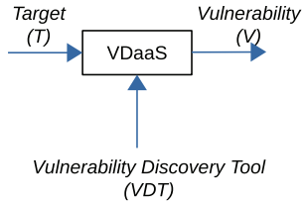
Cybercriminal service model
An application of “service science”
Input
Output
Support
Smaller services can compose into larger ones, including with iteration-based refinement
Notes:
Specialization, commercialization, and cooperation form the crux of the cybercrime business
VDT example:
target software is input,
vulnerability is output,
support are tools like Metasploit, wireshark, W3af, etc.
Legal version is a bug bounty program! Could VD on others’ software be legal? Maybe it is …

Slide 10
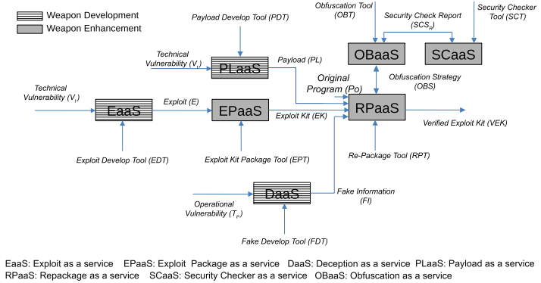
Composition: Exploit kit development service
Notes:
DaaS: generates fake information like a fake website, fake emails, or fake software which is delivered to a target. Used to develop exploit for non-technical vulnerability
Payload: Atomic malicious program performing singular function, or combination of independent ones. It’s the bad stuff you want delivered.
RPaaS: Leverages OBaaS to repackage the exploit to evade detection
“For example, in the Ukraine power grid cyber attack [39], the spear-fishing emails from
DaaS (fake information), the exploit kit targeting vulnerabilities, including CVE-2014-4114, CVE2010-3333 from EPaaS (exploit kit), the KillDisk, a destructive data-wiping utility, and the SSH

Slide 11
Ukraine power grid attack
For example, in the Ukraine power grid cyber attack,
the spear-fishing emails from DaaS (fake information),
the exploit kit targeting vulnerabilities, … from EPaaS (exploit kit),
the KillDisk, a destructive data-wiping utility, and the SSH backdoor to maintain persistent access from PLaaS (payload),
were used in tandem to successfully break into the Ukrainian power grid system.
In the second step of the same attack, malicious firmware (from PLaaS) developed based on domain knowledge collected from the distribution management system,
which was tested by the simulated power grid system (from SCaaS), was uploaded to the system and to attack the ICS components.

Slide 12
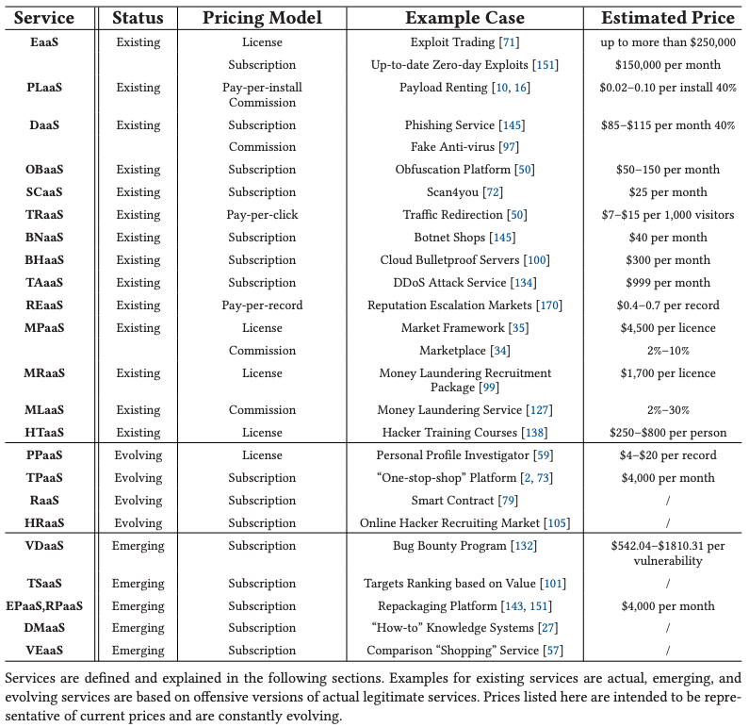
Status and typical pricing of cybercrime services
Article published July 2018
Notes:
Botnet as a service via tools such as Zeus and Aldi. Zombie machines orchestrated via command and control channel
Traffic redirection as a service: Drive-by-download. E.g., “search engine poisoning”
Bullet-proof hosting services – let criminals host without question! Russia etc.
Traffic as a service – DDoS, e.g., via Botnet. Ad fraud.
Reputation escalation as a service – likes, reviews
Personal profile as a service -- identity theft info
Domain knowledge as a service – for facilitating future attacks
Tareget selection as a service
Money laundering, and mules
Hacker reputation as a service
Value evaluation as a service
Marketplace as a service (!) – trusted point! Bad if subverted
Kinda crazy the level of “financial products” too!

Slide 13
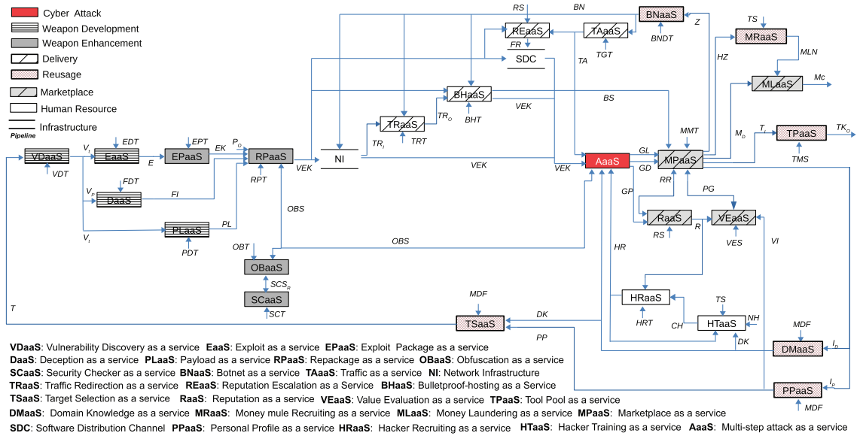
Putting it all together: Multi-step attack as a service
Notes:
Cybercriminal ecosystem framework

Slide 14
Example Costs: Ransomware
To run a ransomware attack as a business, a cybercriminal can
buy BNaaS (botnet) for $999 per month,
a traffic redirection protocol for $600,
six servers as a part of BHaaS (bulletproof server) for $1,800 per month,
access to the Neutrino exploit kit in EPaaS (exploit package) for $4,000,
a ransomware payload with customer support in PLaaS (payload) for $3,000 and
the traffic redirection service TRaaS to redirect victims to servers for $600 per month.
To further increase the effectiveness of an attack, a cybercriminal can
hire a qualified hacker from HRaaS for $2,000 per month, and
employ an obfuscation service from OBaaS to repackage the exploit kit and payload for $600 per month.
Finally, to reduce risk of arrest, services to monetize benefits in the wake of a cyber attack as a part of MLaaS (money laundering) can be accessed for a fee of $400 and 40% commission on processed funds.

Slide 15
Ransomware Benefits and ROI
Assume 30,000 people are redirected per day, of which 10% are victims of a ransomware attack where 0.5% of victims pay a $300 ransom.
Though only 450 victims (0.05% of total users redirected) will end up paying the ransom over a period of one month (30 days), this brings the cybercriminal’s monthly earnings to $135,000.
We can see that the Return-On-Investment (ROI), even when only a small proportion of people end up paying a ransom, is as high as 504.52%, an impressive ROI for a business.
The highest industrial ROI, which is from the Tobacco industry, is only 50.63% in August 2017
Notes:
Using the reports from CSIMarket for comparison, the highest industrial ROI, which is from the Tobacco industry, is only 50.63% in August 2017; in fact, this theoretical cybercrime operation would be ranked as one of the top seven best performing companies in the world in terms of ROI.
If we use the numbers from the Angler revenue report, which shows that 9,515 users pay the ransom per month, a number more than 20 times larger than the 450 users dictated by our assumptions, then the ROI of this operation would reach 12,682.30%.

Slide 16
Discussion points
General: What does all of this teach us?
This paper was from 2016. What’s happened in the meantime that might have changed things?
How would we decide where is to disrupt this network, if we wanted to try?
How do nation-state actors fit into this framework?
What is the implication of “two way” services like vulnerability discovery training?
Attacker motivations (”psychological”) might sometimes differ from defenders (reduce loss). Ramifications?

Slide 17
Readings

Slide 18
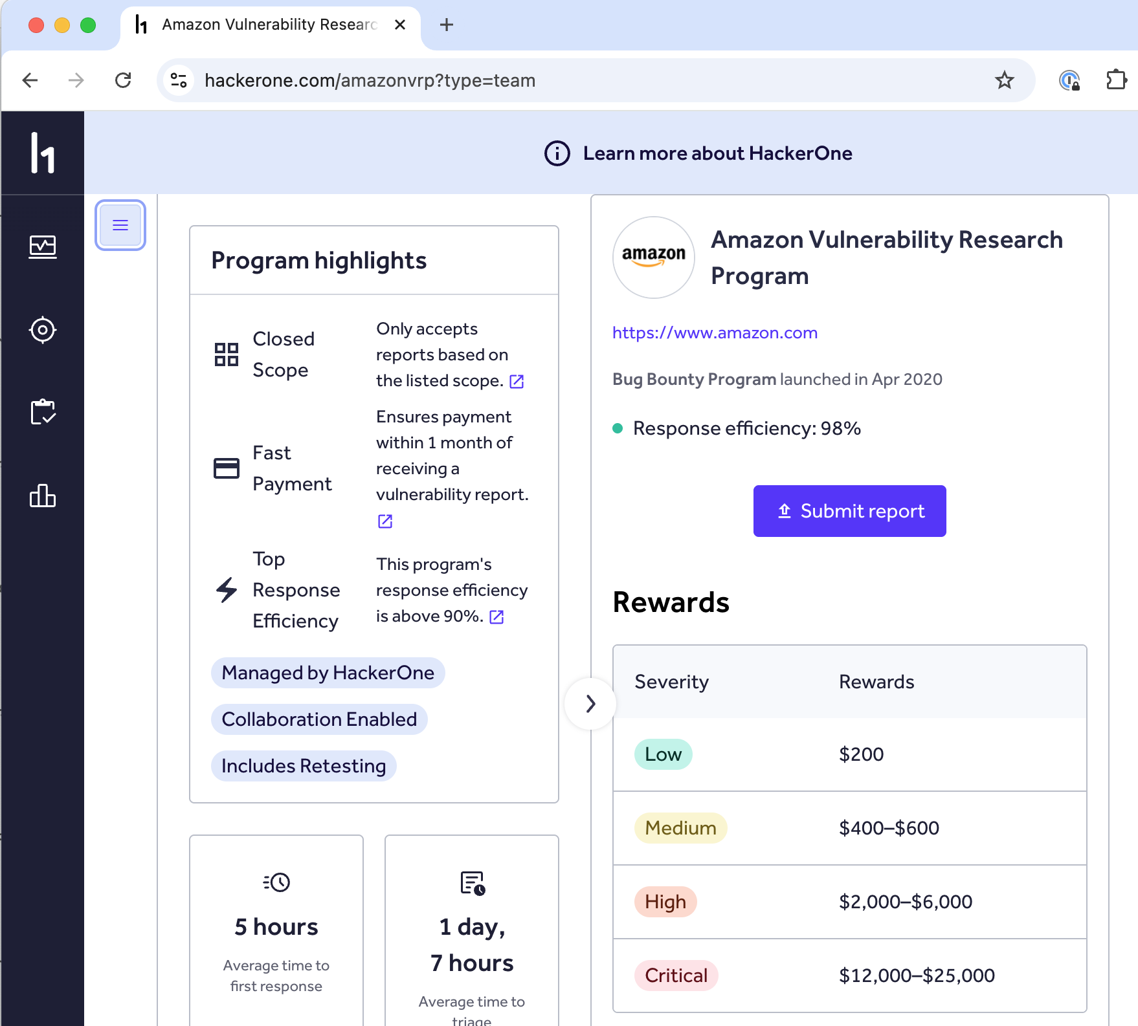
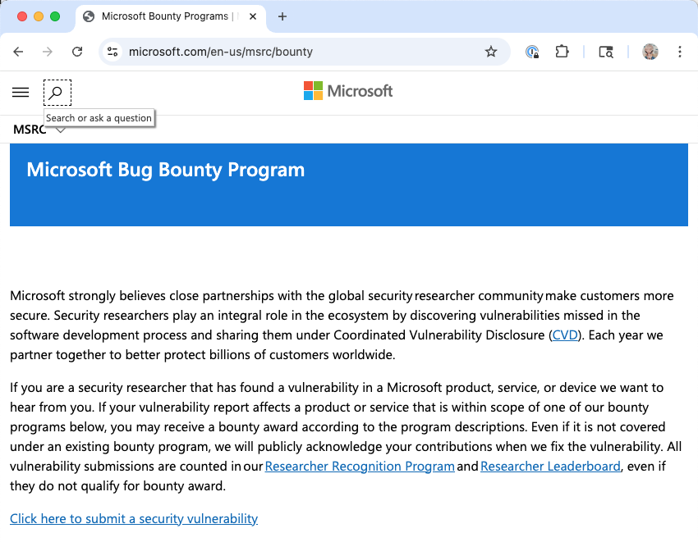
Bug bounty programs
Google has one, Microsoft too, and so does Amazon (via HackerOne)
Notes:
What are these programs? Pay “security researchers” for bugs

Slide 19
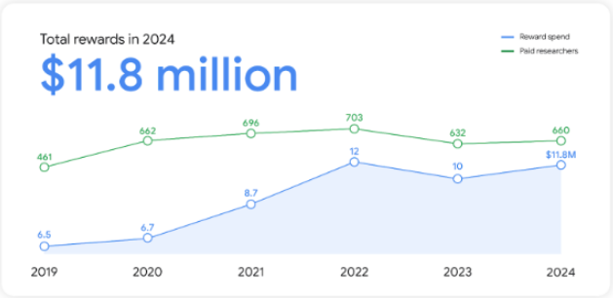
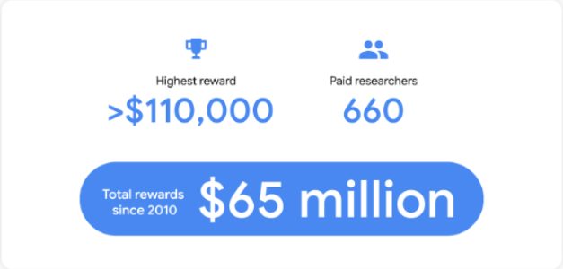
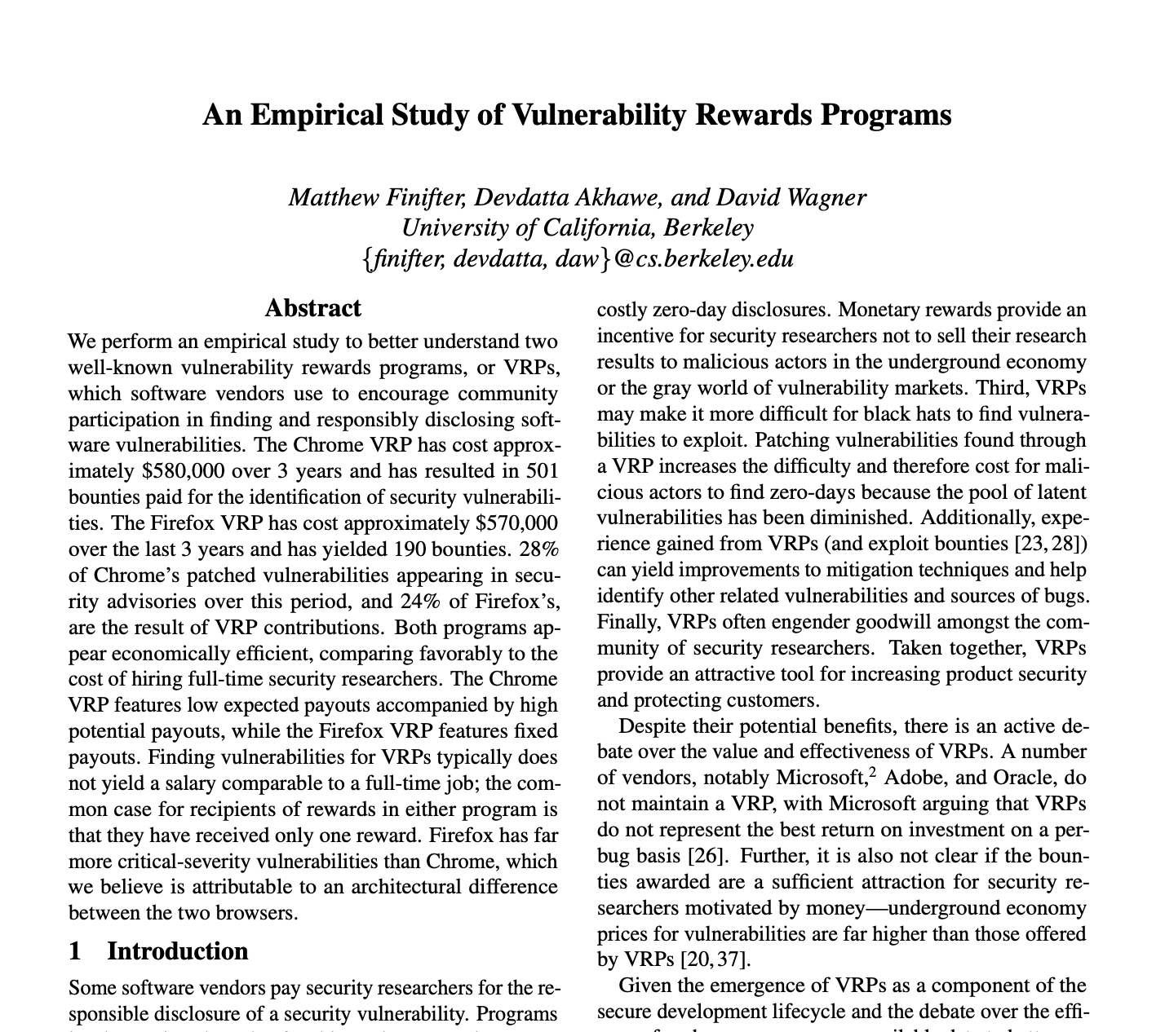
2024 Google rewards
Much bigger than in 2013!
$6.5M in 2019 for 461 vulns = $14,100 per bug
$11.8M in 2024 for 660 vulns = $16,939 per bug
In early 2013, $1,000 - $3,133.7 (max) paid per vulnerability per Finifter et al, “An Empirical Study of Vulnerability Rewards Programs,” USENIX 2013.

Slide 20
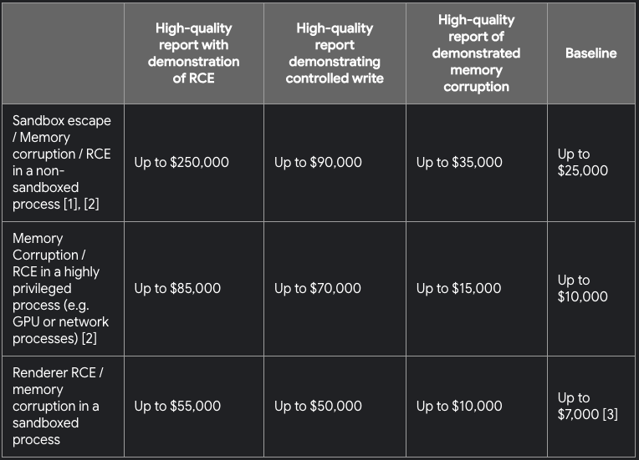
Chrome
337 reports of unique, valid security bugs
Awarded $3.4 million to 137 Chrome VRP researchers

Slide 21
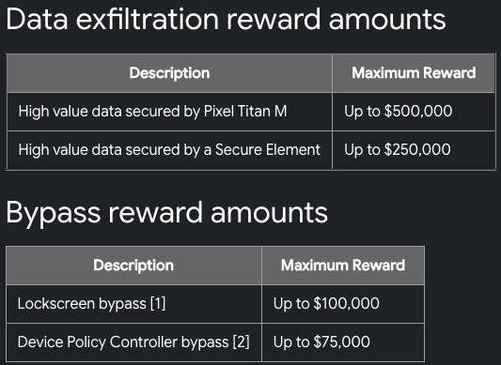
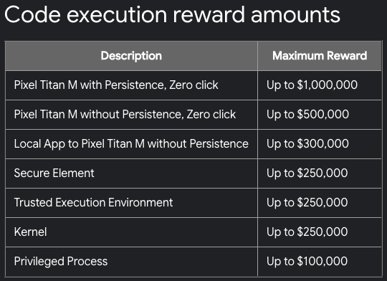
Android and devices
Awarded over $3.3 million total
8% decrease in the total submissions
2% increase in the number of critical and high vulnerabilities

Slide 22
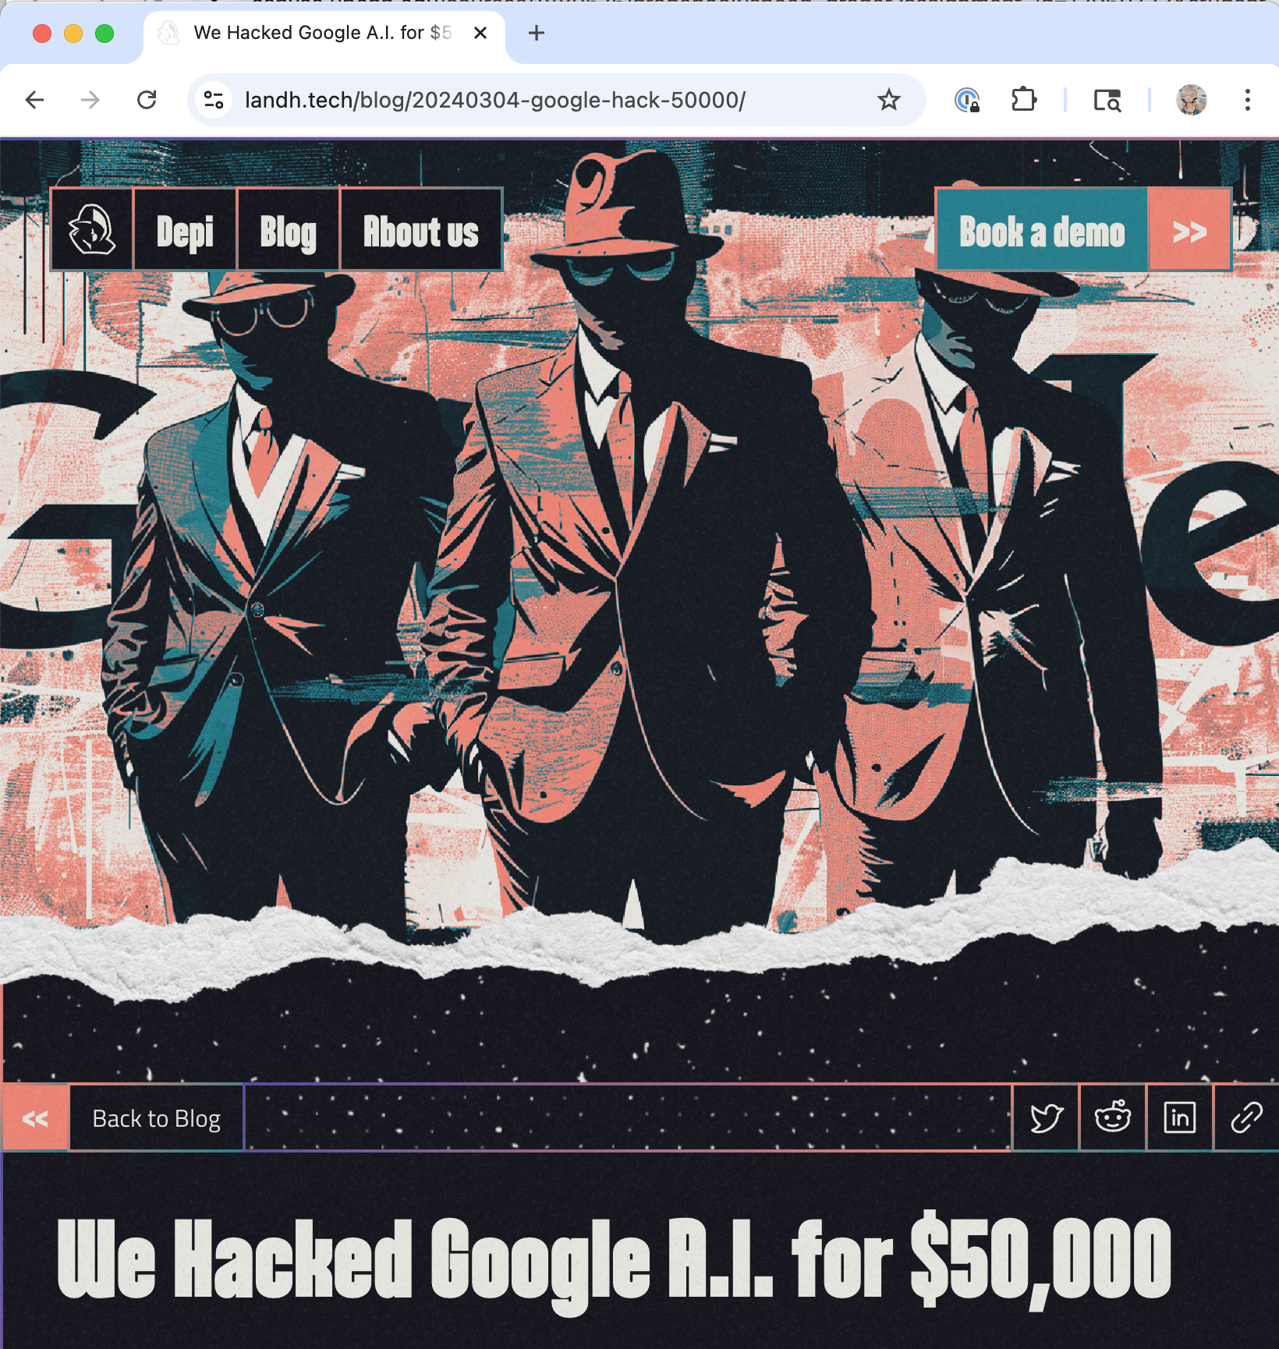
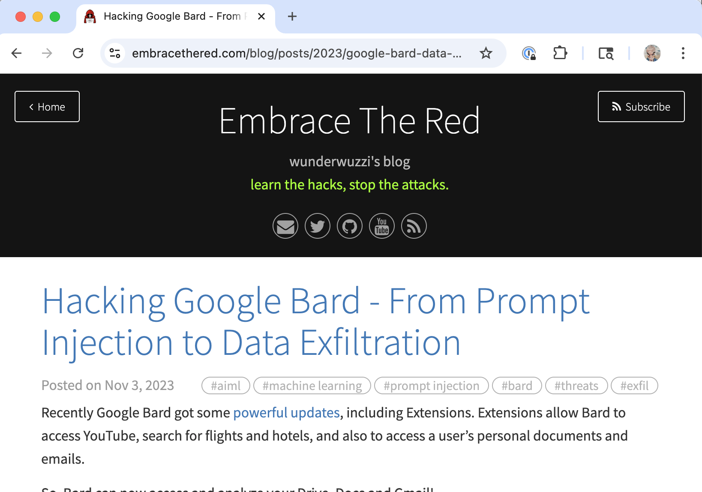
Generative AI
Prompt attacks
Training Data Extraction
Manipulating Models
Adversarial Perturbation
Model Theft / Exfiltration
150 bug reports – over $55,000 in rewards so far – with one-in-six leading to key improvements

Slide 23
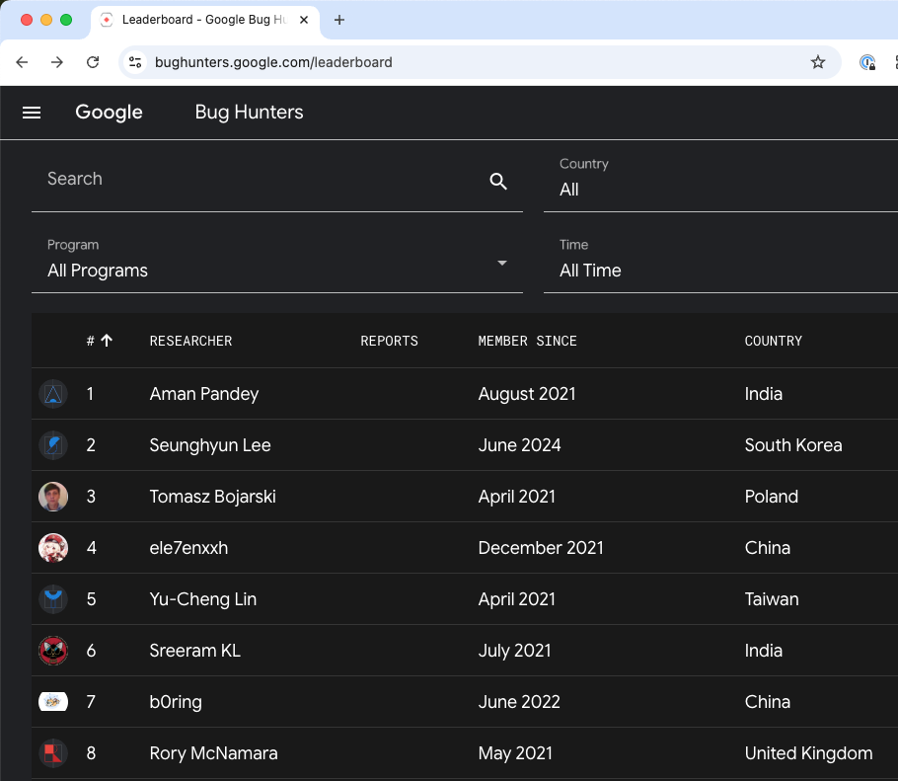
Leaders all time

Slide 24
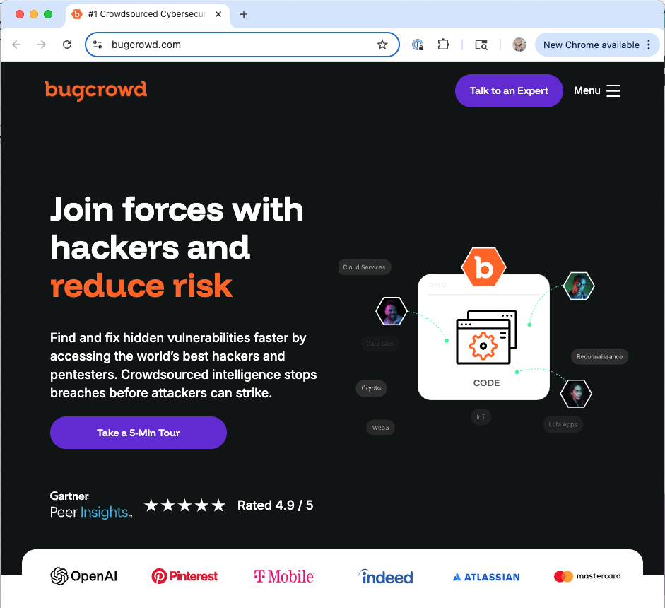
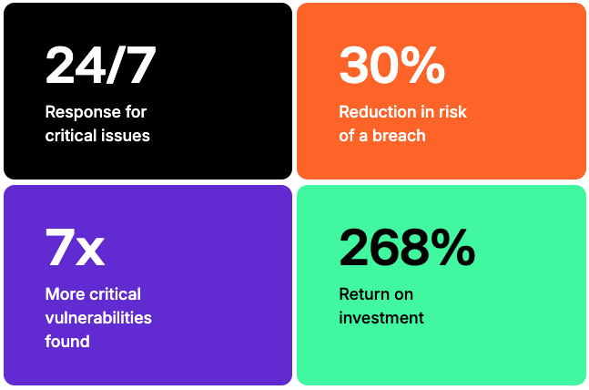
Bugcrowd
Bug bounties as a service (and other programs, too)
Claimed benefits:

Slide 25
Return on investment?
What is the calculation used to determine the benefits?
What are the incentives to find and fix vulnerabilities in your systems
If you are a software provider
If you are a service provider
If you are a government agency
Worry: Hackers will sell your vulnerabilities on the dark web for more $$
Notes:
Prior economic models we have discussed have mostly ignored the attacker. What are the economics from the attacker’s POV? How can these be combined into a more complete model?

Slide 26
Discussion points
General takeaways?
What can you glean from Google’s results about their security?
How would you tell whether the program is really game-changing, i.e., significantly raising costs for attackers?
Bug bounty programs:
When would you be motivated to start a bug bounty program?
Now that AI is becoming a big deal, how are these programs changing (or should change)?
How do these programs affect the attack ecosystem described in the other paper?
Concerns about how “security researchers” are compensated?

